Slide 1
Linear Combinations and Spanning Sets

Slide 2

A set of two vectors forms a spanning set for $R^{2}$ if every vector in $R^{2}$ can be written as a linear combination of those two vectors.

Slide 3
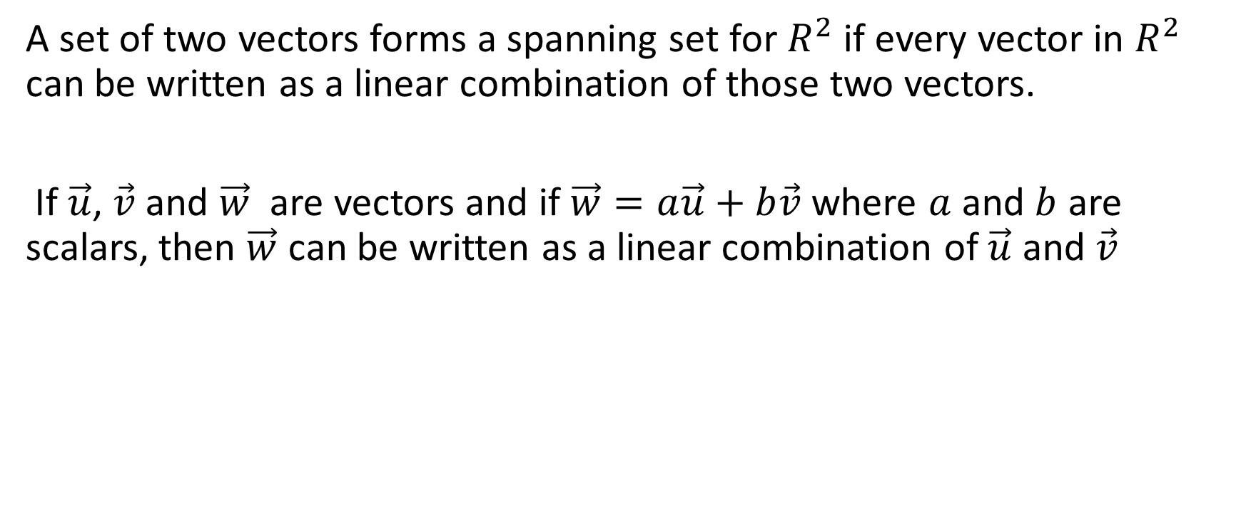
A set of two vectors forms a spanning set for $R^{2}$ if every vector in $R^{2}$ can be written as a linear combination of those two vectors.
If $\vec{u}$, $\vec{v}$ and $\vec{w}$ are vectors and if $\vec{w}=a\vec{u}+b\vec{v}$ where $a$ and $b$ are scalars, then $\vec{w}$ can be written as a linear combination of $\vec{u}$ and $\vec{v}$

Slide 4
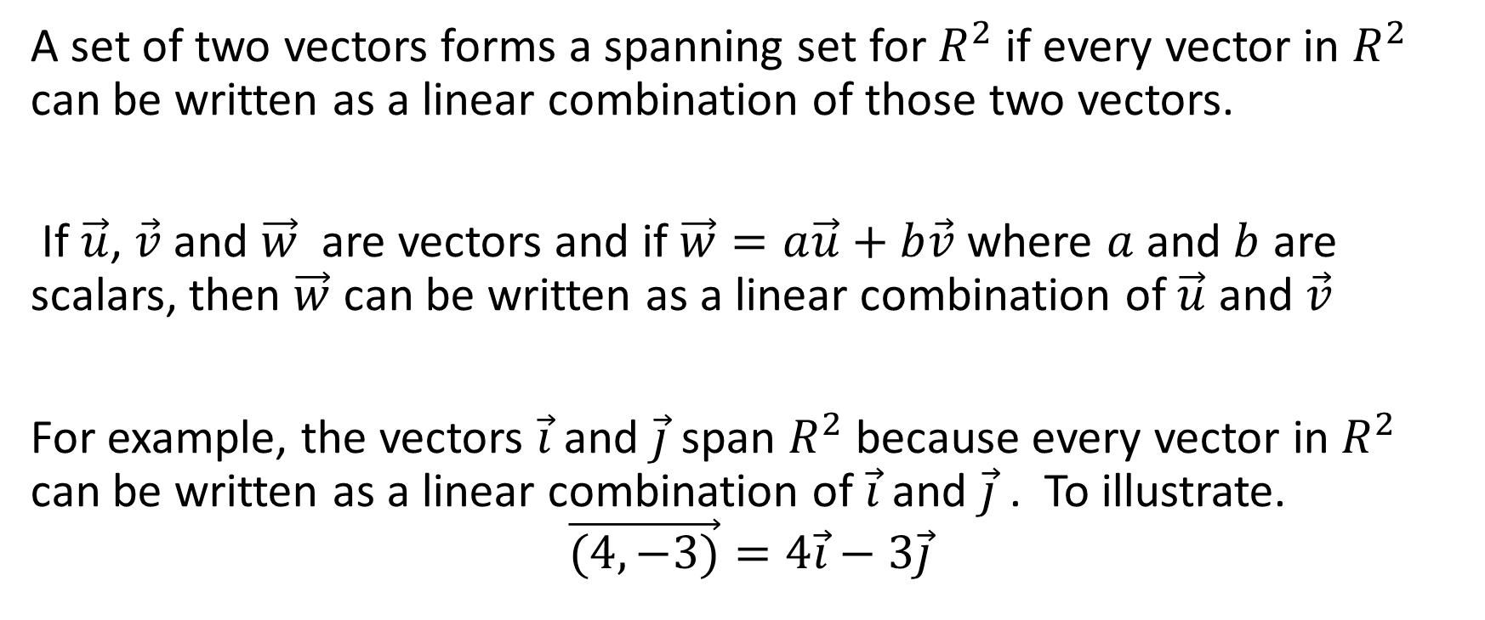
A set of two vectors forms a spanning set for $R^{2}$ if every vector in $R^{2}$ can be written as a linear combination of those two vectors.
If $\vec{u}$, $\vec{v}$ and $\vec{w}$ are vectors and if $\vec{w}=a\vec{u}+b\vec{v}$ where $a$ and $b$ are scalars, then $\vec{w}$ can be written as a linear combination of $\vec{u}$ and $\vec{v}$
For example, the vectors $\vec{i}$ and $\vec{j}$ span $R^{2}$ because every vector in $R^{2}$ can be written as a linear combination of $\vec{i}$ and $\vec{j}$ . To illustrate.
$$\vec{(4,−3)}=4\vec{i}−3\vec{j}$$

Slide 5

Example
Show that $\vec{v}=\vec{(4,23)}$ can be written as a linear combination of the set of vectors $\left\{\vec{(−1,4)} , \vec{(2,5)}\right\}$.

Slide 6
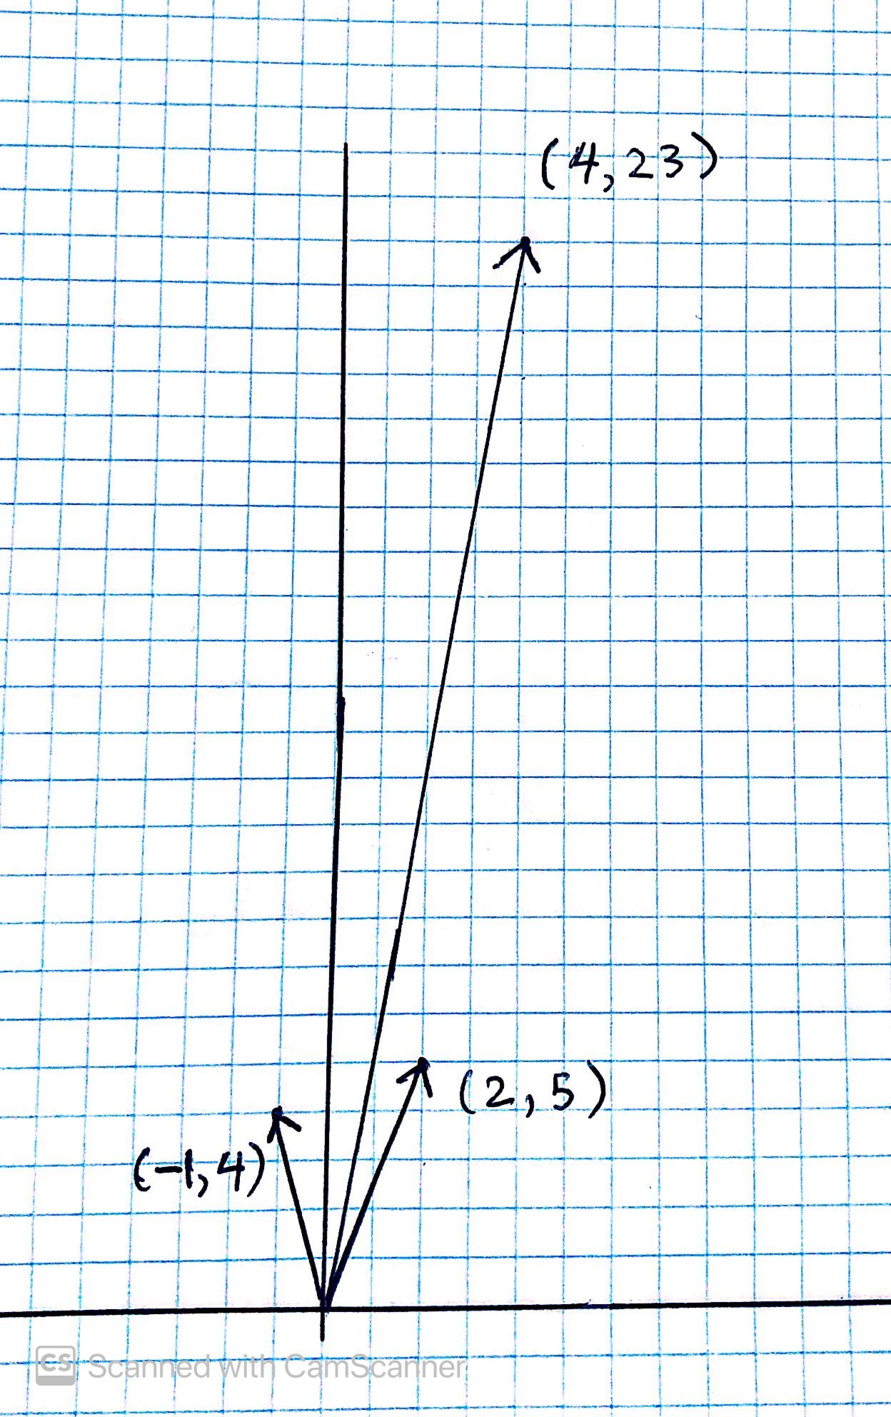
In other words, we want to show that we can get from the origin to the point (4, 23) using only the two vectors shown.

Slide 7
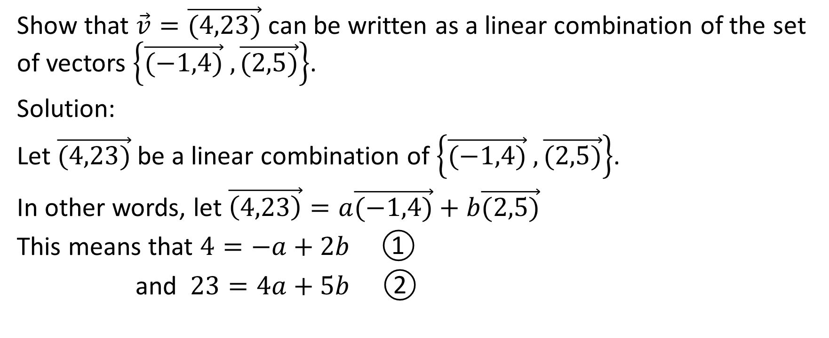
Show that $\vec{v}=\vec{(4,23)}$ can be written as a linear combination of the set of vectors $\left\{\vec{(−1,4)} , \vec{(2,5)}\right\}$.
Solution:
Let $\vec{(4,23)}$ be a linear combination of $\left\{\vec{(−1,4)} , \vec{(2,5)}\right\}$.
In other words, let $\vec{\left(4,23\right)}=a\vec{(−1,4)}+b\vec{(2,5)}$
This means that $4=−a+2b$①
and $23=4a+5b$ ②

Slide 8
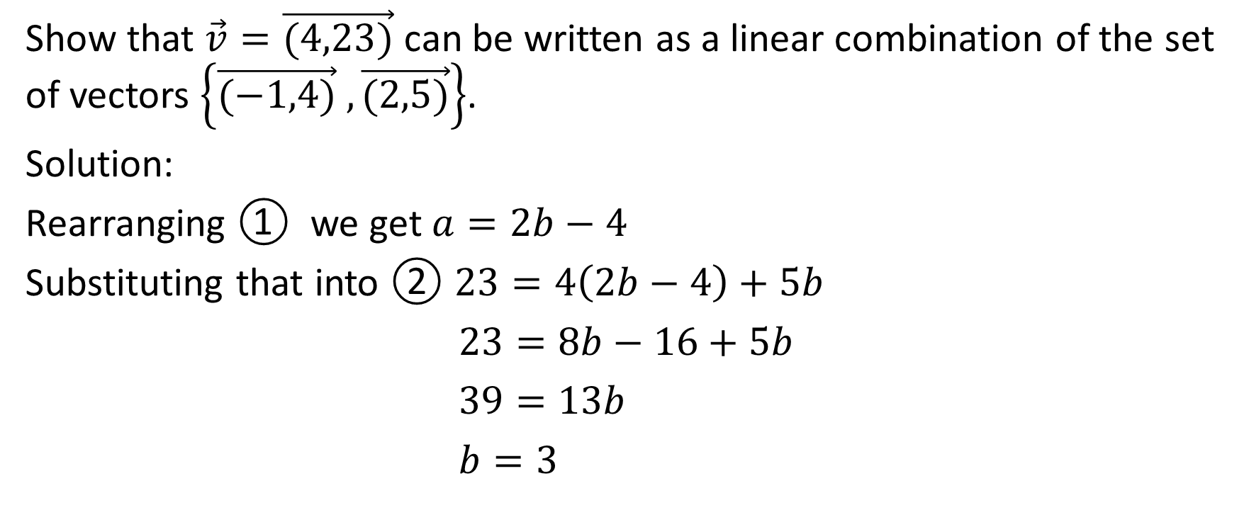
Show that $\vec{v}=\vec{(4,23)}$ can be written as a linear combination of the set of vectors $\left\{\vec{(−1,4)} , \vec{(2,5)}\right\}$.
Solution:
Rearranging ① we get $a=2b−4$
Substituting that into ② $23=4\left(2b−4\right)+5b$
$23=8b−16+5b$
$39=13b$
$b=3$

Slide 9
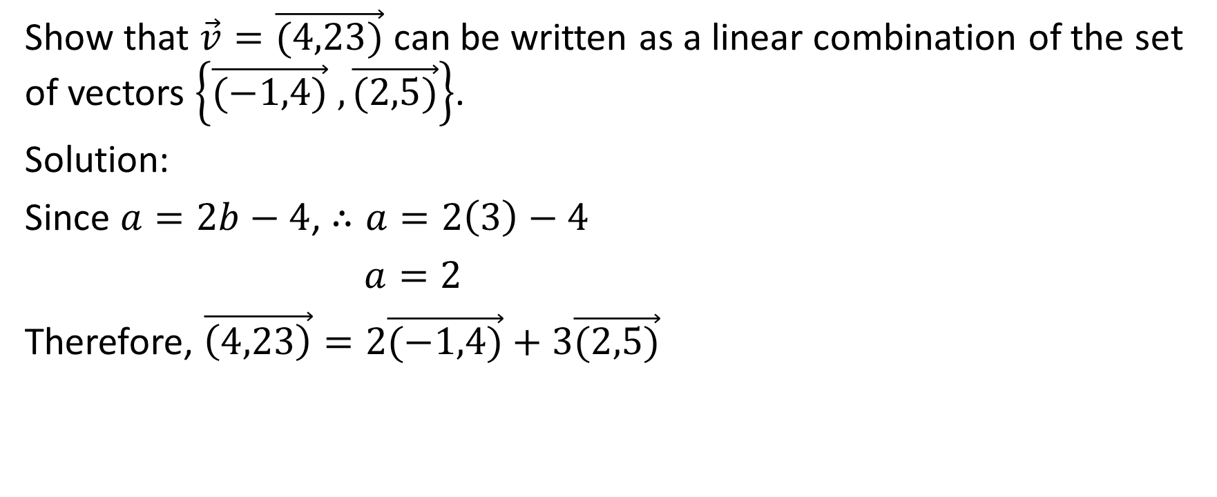
Show that $\vec{v}=\vec{(4,23)}$ can be written as a linear combination of the set of vectors $\left\{\vec{(−1,4)} , \vec{(2,5)}\right\}$.
Solution:
Since $a=2b−4$, $∴a=2\left(3\right)−4$
$a=2$
Therefore, $\vec{\left(4,23\right)}=2\vec{(−1,4)}+3\vec{(2,5)}$

Slide 10
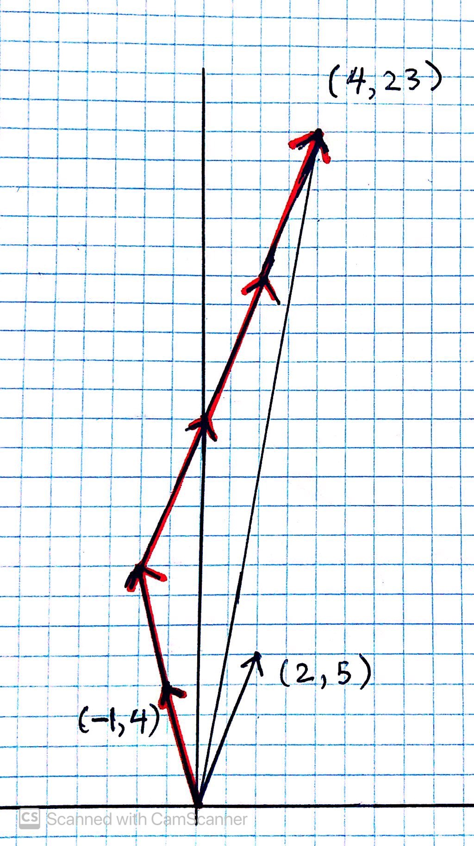

Slide 11
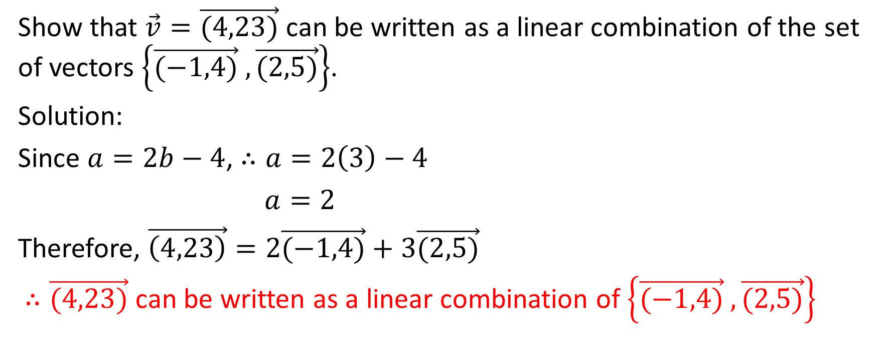
Show that $\vec{v}=\vec{(4,23)}$ can be written as a linear combination of the set of vectors $\left\{\vec{(−1,4)} , \vec{(2,5)}\right\}$.
Solution:
Since $a=2b−4$, $∴a=2\left(3\right)−4$
$a=2$
Therefore, $\vec{\left(4,23\right)}=2\vec{(−1,4)}+3\vec{(2,5)}$
$∴\vec{(4,23)}$ can be written as a linear combination of $\left\{\vec{(−1,4)} , \vec{(2,5)}\right\}$

Slide 12

Term to Know: Spanning Set
Before we do our next example, let’s discuss the term spanning set.
A spanning set of $R^{2}$ exists if every vector in $R^{2}$ can be written as a linear combination of those vectors.

Slide 13

Example
Show that the set of vectors $\left\{\vec{\left(2,3\right)}, \vec{\left(−4, −6\right)}\right\}$ is not a spanning set of $R^{2}$

Slide 14
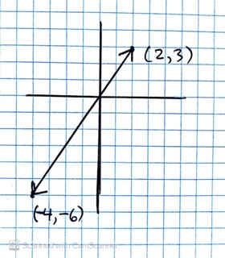
Show that the set of vectors $\left\{\vec{\left(2,3\right)}, \vec{\left(−4, −6\right)}\right\}$ is not a spanning set of $R^{2}$

Slide 15
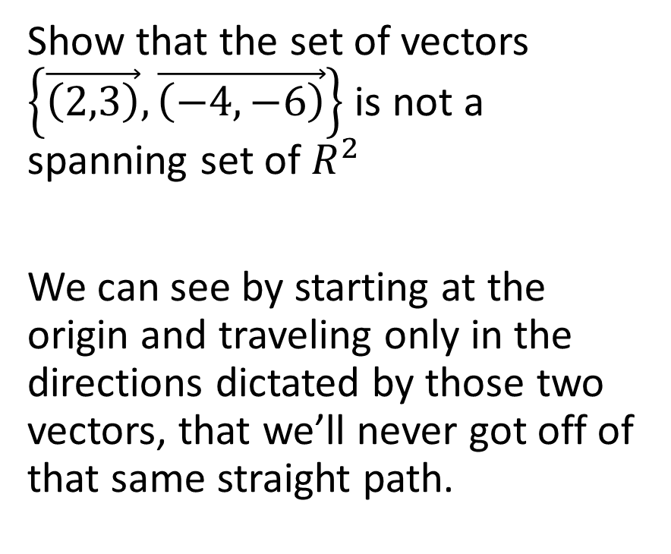
Show that the set of vectors $\left\{\vec{\left(2,3\right)}, \vec{\left(−4, −6\right)}\right\}$ is not a spanning set of $R^{2}$
We can see by starting at the origin and traveling only in the directions dictated by those two vectors, that we’ll never got off of that same straight path.

Slide 16
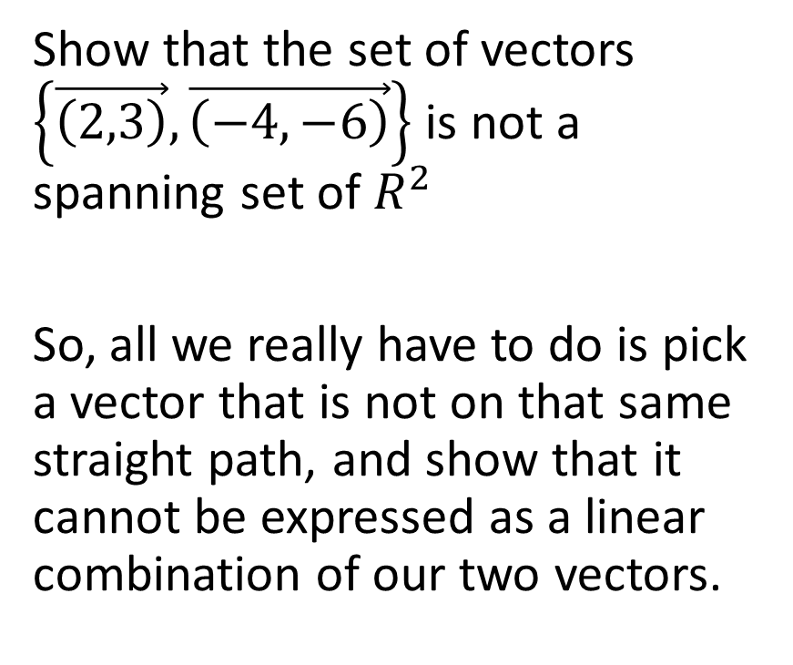
Show that the set of vectors $\left\{\vec{\left(2,3\right)}, \vec{\left(−4, −6\right)}\right\}$ is not a spanning set of $R^{2}$
So, all we really have to do is pick a vector that is not on that same straight path, and show that it cannot be expressed as a linear combination of our two vectors.

Slide 17
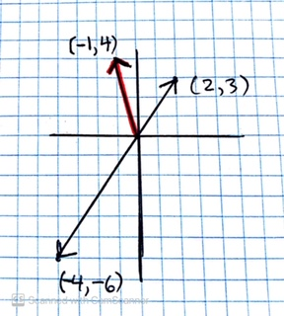
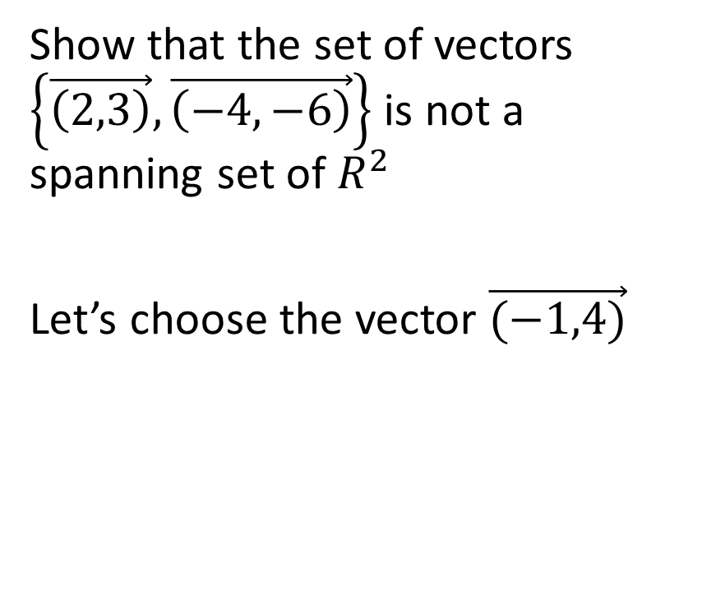
Show that the set of vectors $\left\{\vec{\left(2,3\right)}, \vec{\left(−4, −6\right)}\right\}$ is not a spanning set of $R^{2}$
Let’s choose the vector $\vec{(−1,4)}$

Slide 18
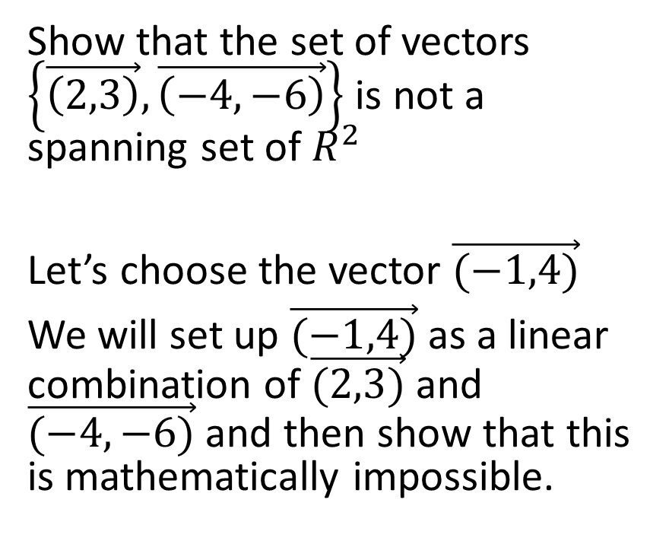
Show that the set of vectors $\left\{\vec{\left(2,3\right)}, \vec{\left(−4, −6\right)}\right\}$ is not a spanning set of $R^{2}$
Let’s choose the vector $\vec{(−1,4)}$
We will set up $\vec{(−1,4)}$ as a linear combination of $\vec{(2,3)}$ and $\vec{(−4,−6)}$and then show that this is mathematically impossible.

Slide 19
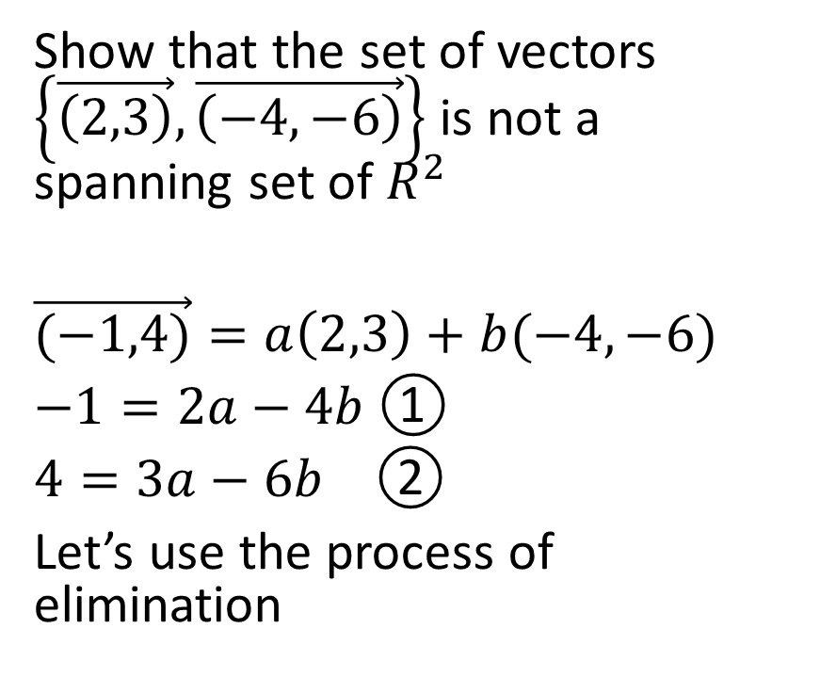
Show that the set of vectors $\left\{\vec{\left(2,3\right)}, \vec{\left(−4, −6\right)}\right\}$ is not a spanning set of $R^{2}$
$\vec{(−1,4)}=a\left(2,3\right)+b(−4,−6)$
$−1=2a−4b$ ①
$4=3a−6b$ ②
Let’s use the process of elimination

Slide 20
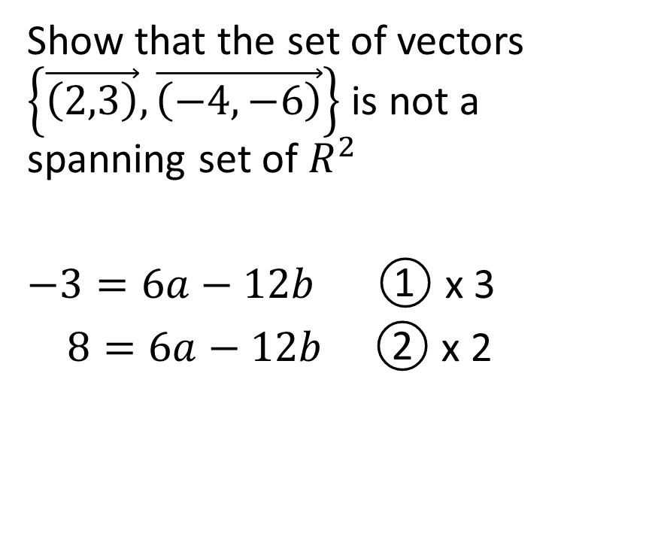
Show that the set of vectors $\left\{\vec{\left(2,3\right)}, \vec{\left(−4, −6\right)}\right\}$ is not a spanning set of $R^{2}$
$−3=6a−12b$ ① x 3
$8=6a−12b$ ② x 2

Slide 21
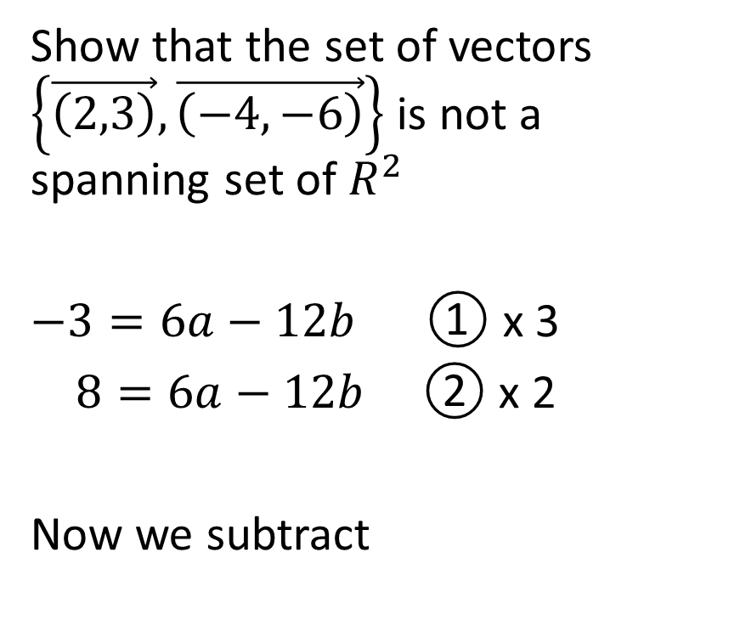
Show that the set of vectors $\left\{\vec{\left(2,3\right)}, \vec{\left(−4, −6\right)}\right\}$ is not a spanning set of $R^{2}$
$−3=6a−12b$ ① x 3
$8=6a−12b$ ② x 2
Now we subtract

Slide 22
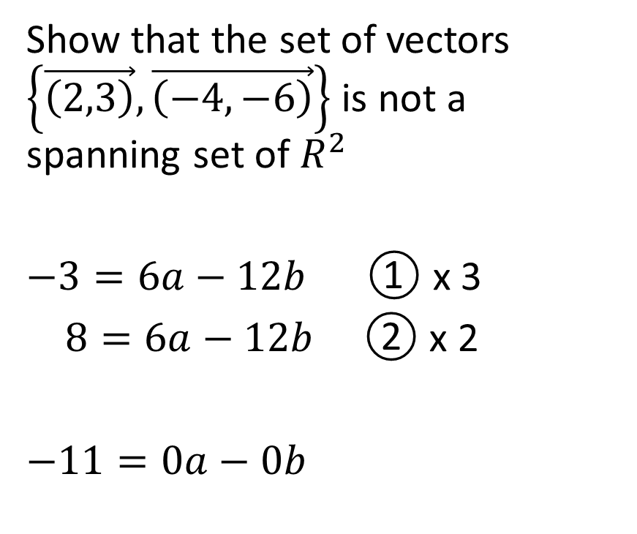
Show that the set of vectors $\left\{\vec{\left(2,3\right)}, \vec{\left(−4, −6\right)}\right\}$ is not a spanning set of $R^{2}$
$−3=6a−12b$ ① x 3
$8=6a−12b$ ② x 2
$−11=0a−0b$

Slide 23
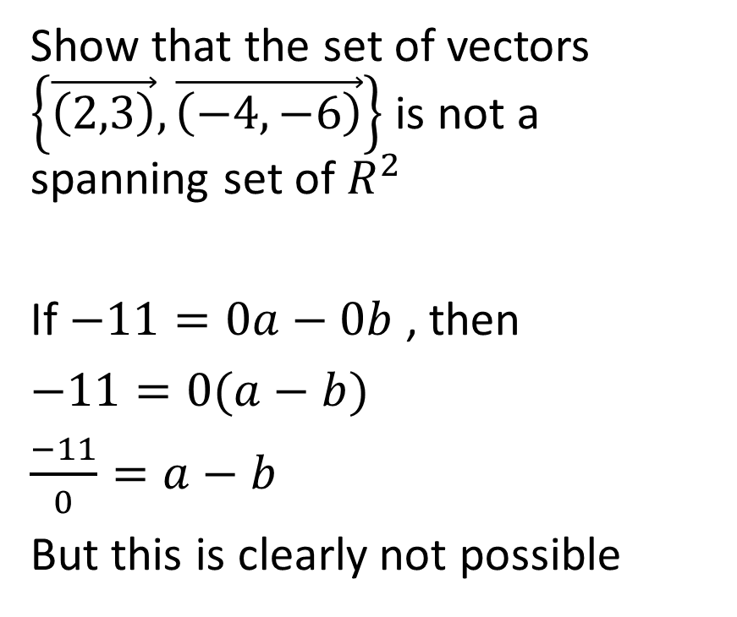
Show that the set of vectors $\left\{\vec{\left(2,3\right)}, \vec{\left(−4, −6\right)}\right\}$ is not a spanning set of $R^{2}$
If $−11=0a−0b$, then
$−11=0(a−b)$
$\frac{−11}{0}=a−b$
But this is clearly not possible

Slide 24
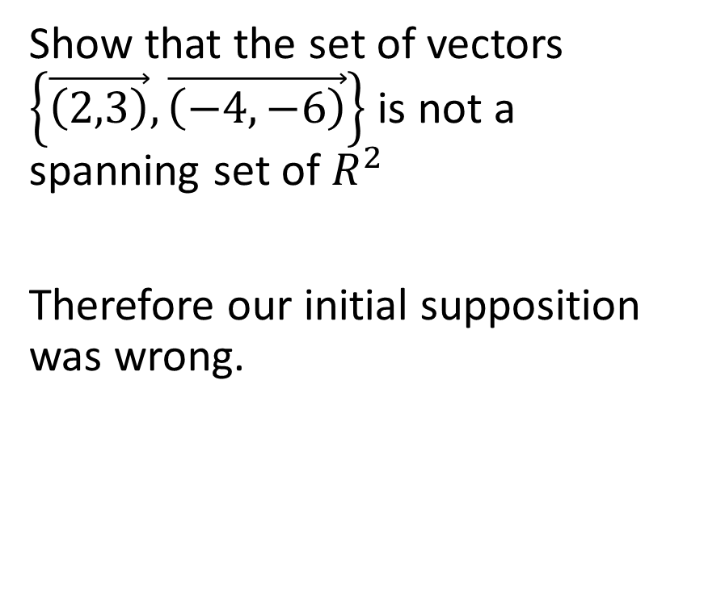
Show that the set of vectors $\left\{\vec{\left(2,3\right)}, \vec{\left(−4, −6\right)}\right\}$ is not a spanning set of $R^{2}$
Therefore our initial supposition was wrong.

Slide 25
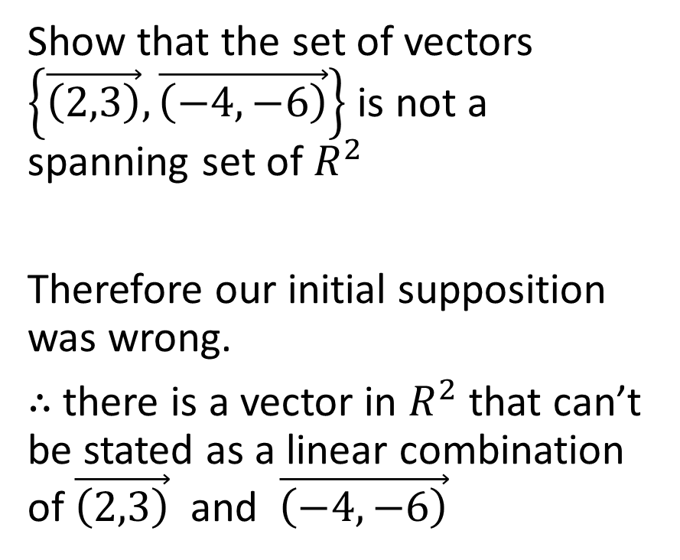
Show that the set of vectors $\left\{\vec{\left(2,3\right)}, \vec{\left(−4, −6\right)}\right\}$ is not a spanning set of $R^{2}$
Therefore our initial supposition was wrong.
$∴$ there is a vector in $R^{2}$ that can’t be stated as a linear combination of $\vec{\left(2,3\right)}$and $\vec{\left(−4, −6\right)}$

Slide 26
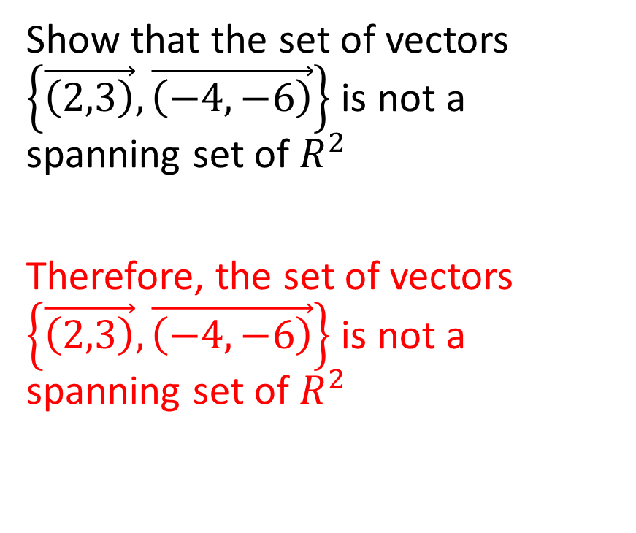
Show that the set of vectors $\left\{\vec{\left(2,3\right)}, \vec{\left(−4, −6\right)}\right\}$ is not a spanning set of $R^{2}$
Therefore, the set of vectors $\left\{\vec{\left(2,3\right)}, \vec{\left(−4, −6\right)}\right\}$ is not a spanning set of $R^{2}$

Slide 27

Example
Show that the set of vectors
$$\left\{\left(2, 1\right), (−3, −1)\right\}$$
is a spanning set for $R^{2}$

Slide 28
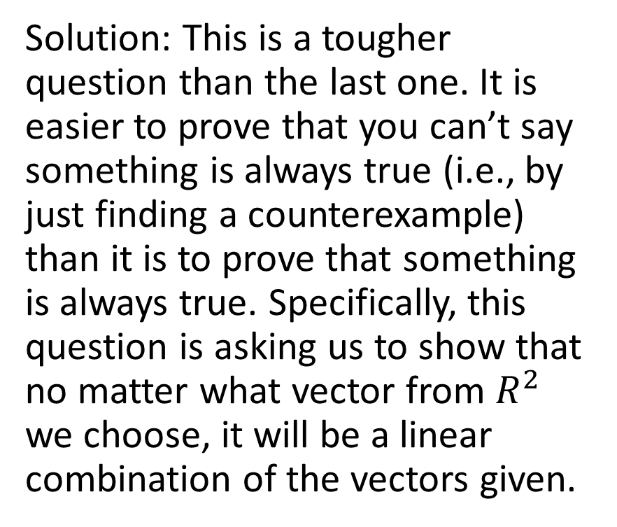
Show that the set of vectors
$$\left\{\left(2, 1\right), (−3, −1)\right\}$$
is a spanning set for $R^{2}$
Solution: This is a tougher question than the last one. It is easier to prove that you can’t say something is always true (i.e., by just finding a counterexample) than it is to prove that something is always true. Specifically, this question is asking us to show that no matter what vector from $R^{2}$ we choose, it will be a linear combination of the vectors given.

Slide 29
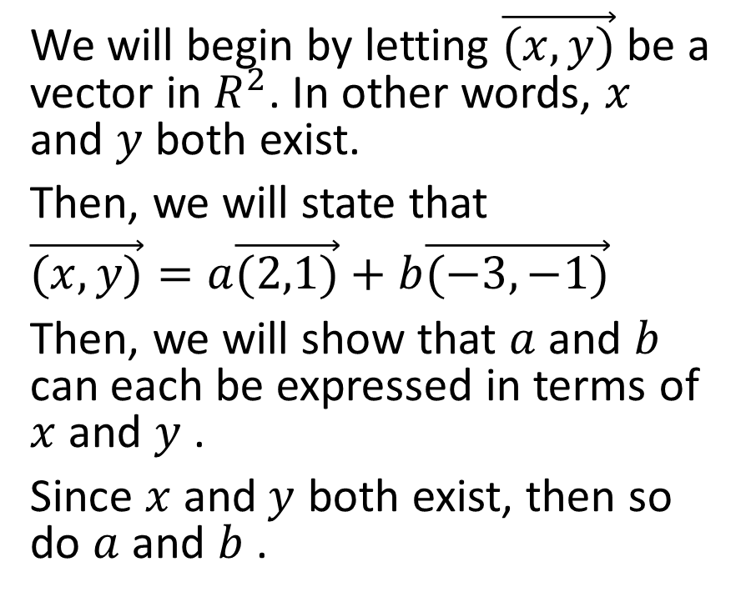

Show that the set of vectors
$$\left\{\left(2, 1\right), (−3, −1)\right\}$$
is a spanning set for $R^{2}$
We will begin by letting $\vec{(x,y)}$ be a vector in $R^{2}$. In other words, $x$ and $y$ both exist.
Then, we will state that
$\vec{(x,y)}=a\vec{(2,1)}+b\vec{(−3,−1)}$
Then, we will show that $a$and $b$ can each be expressed in terms of $x$ and $y$ .
Since $x$ and$y$ both exist, then so do $a$ and $b$ .

Slide 30
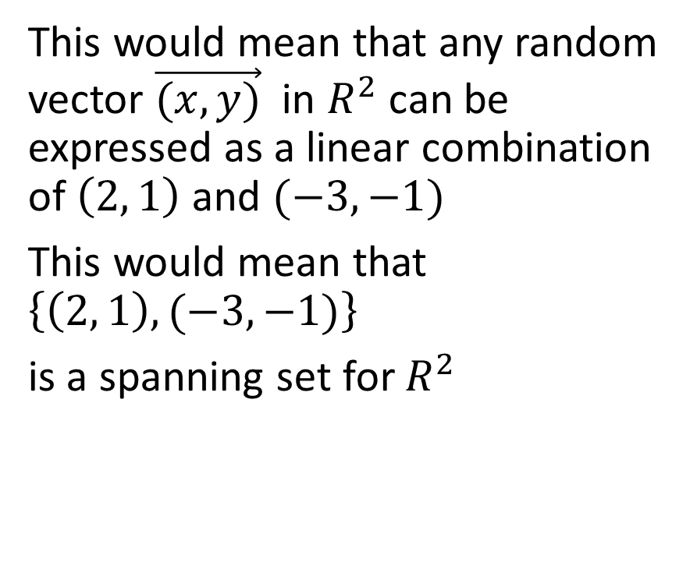
Show that the set of vectors
$$\left\{\left(2, 1\right), (−3, −1)\right\}$$
is a spanning set for $R^{2}$
This would mean that any random vector $\vec{(x,y)}$ in $R^{2}$ can be expressed as a linear combination of $\left(2, 1\right)$ and $(−3, −1)$
This would mean that $\left\{\left(2, 1\right), (−3, −1)\right\}$
is a spanning set for $R^{2}$

Slide 31
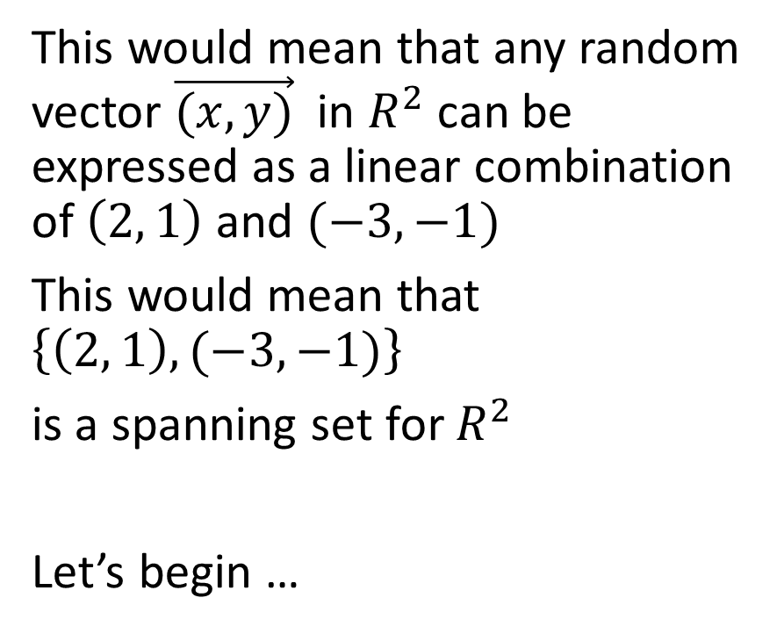
Show that the set of vectors
$$\left\{\left(2, 1\right), (−3, −1)\right\}$$
is a spanning set for $R^{2}$
This would mean that any random vector $\vec{(x,y)}$ in $R^{2}$ can be expressed as a linear combination of $\left(2, 1\right)$ and $(−3, −1)$
This would mean that $\left\{\left(2, 1\right), (−3, −1)\right\}$
is a spanning set for $R^{2}$
Let’s begin …

Slide 32
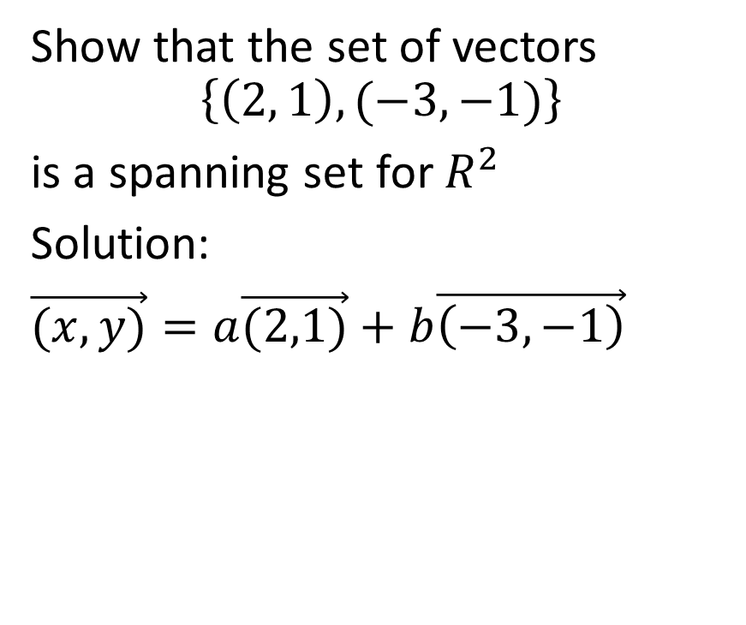
Show that the set of vectors
$$\left\{\left(2, 1\right), (−3, −1)\right\}$$
is a spanning set for $R^{2}$
Solution:
$\vec{(x,y)}=a\vec{(2,1)}+b\vec{\left(−3,−1\right)}$

Slide 33
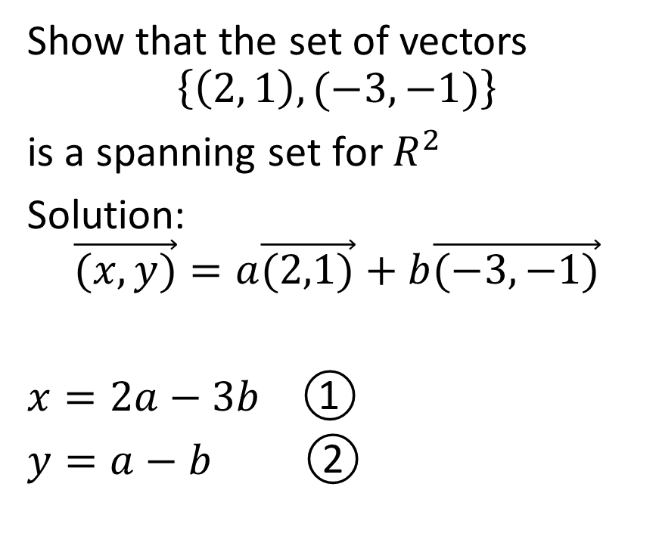
Show that the set of vectors
$$\left\{\left(2, 1\right), (−3, −1)\right\}$$
is a spanning set for $R^{2}$
Solution:
$$\vec{(x,y)}=a\vec{(2,1)}+b\vec{(−3,−1)}$$
$x=2a−3b$ ①
$y=a−b$ ②

Slide 34
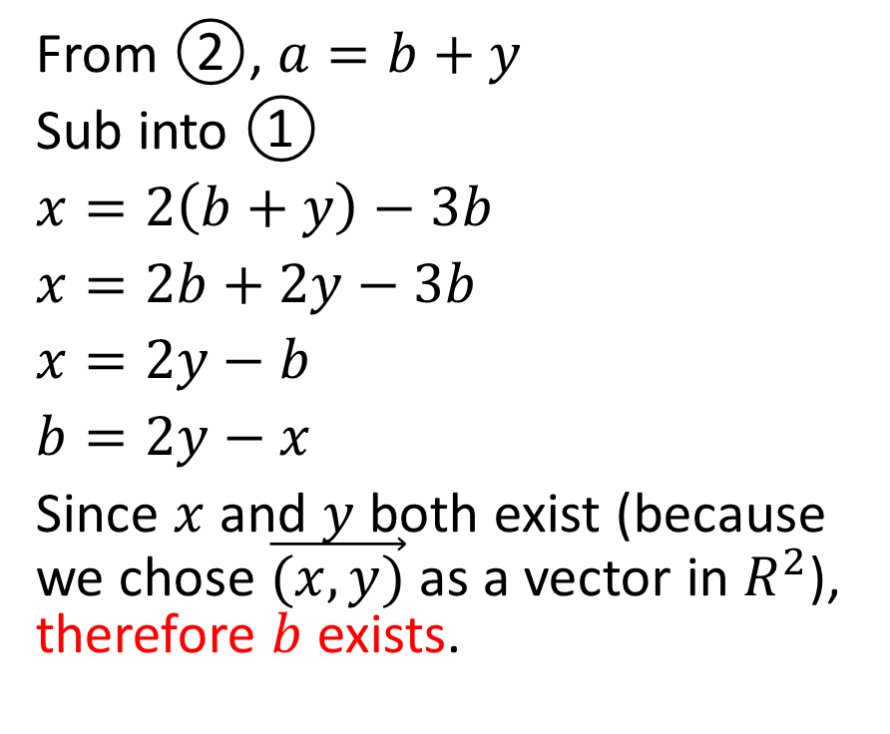
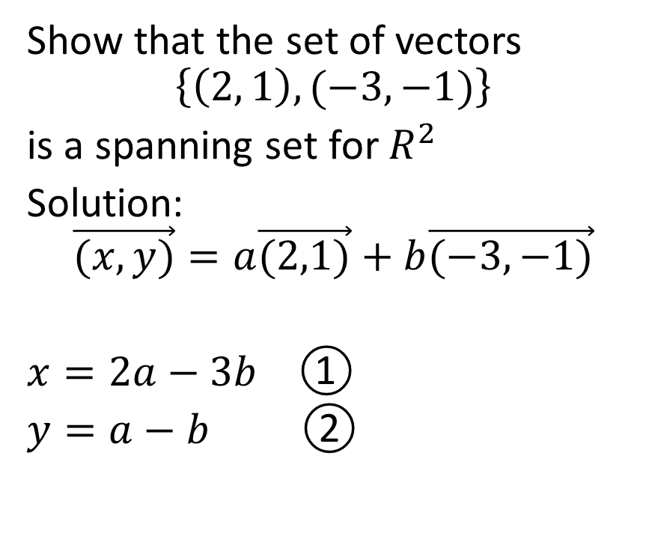
Show that the set of vectors
$$\left\{\left(2, 1\right), (−3, −1)\right\}$$
is a spanning set for $R^{2}$
Solution:
$$\vec{(x,y)}=a\vec{(2,1)}+b\vec{(−3,−1)}$$
$x=2a−3b$ ①
$y=a−b$ ②
From ②, $a=b+y$
Sub into ①
$x=2\left(b+y\right)−3b$
$x=2b+2y−3b$
$x=2y−b$
$b=2y−x$
Since $x$ and $y$ both exist (because we chose $\vec{(x,y)}$ as a vector in $R^{2}$), therefore $b$ exists.

Slide 35
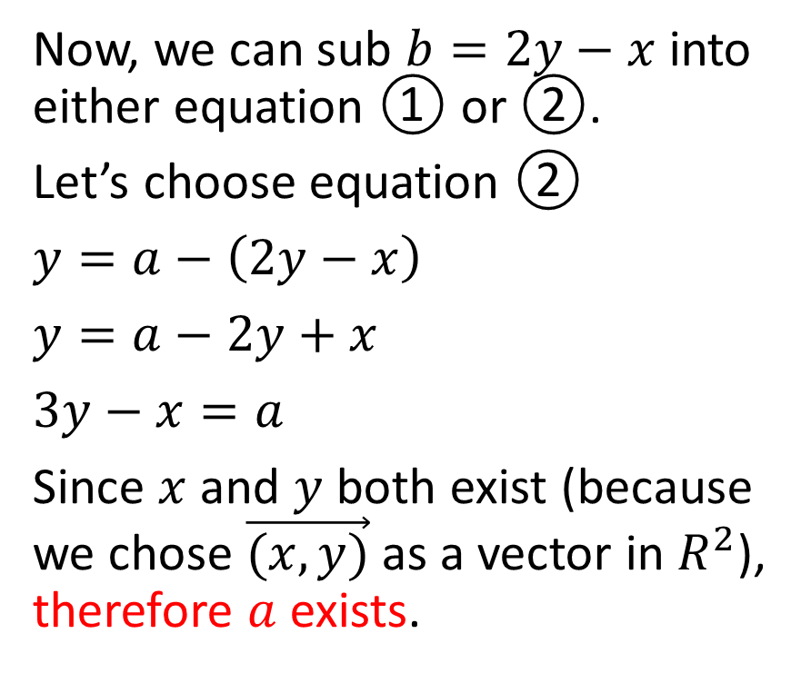
Show that the set of vectors
$$\left\{\left(2, 1\right), (−3, −1)\right\}$$
is a spanning set for $R^{2}$
Solution:
$$\vec{(x,y)}=a\vec{(2,1)}+b\vec{(−3,−1)}$$
$x=2a−3b$ ①
$y=a−b$ ②
Now, we can sub $b=2y−x$ into either equation ① or ②.
Let’s choose equation ②
$y=a−\left(2y−x\right)$
$y=a−2y+x$
$3y−x=a$
Since $x$ and $y$ both exist (because we chose $\vec{(x,y)}$ as a vector in $R^{2}$), therefore $a$ exists.

Slide 36
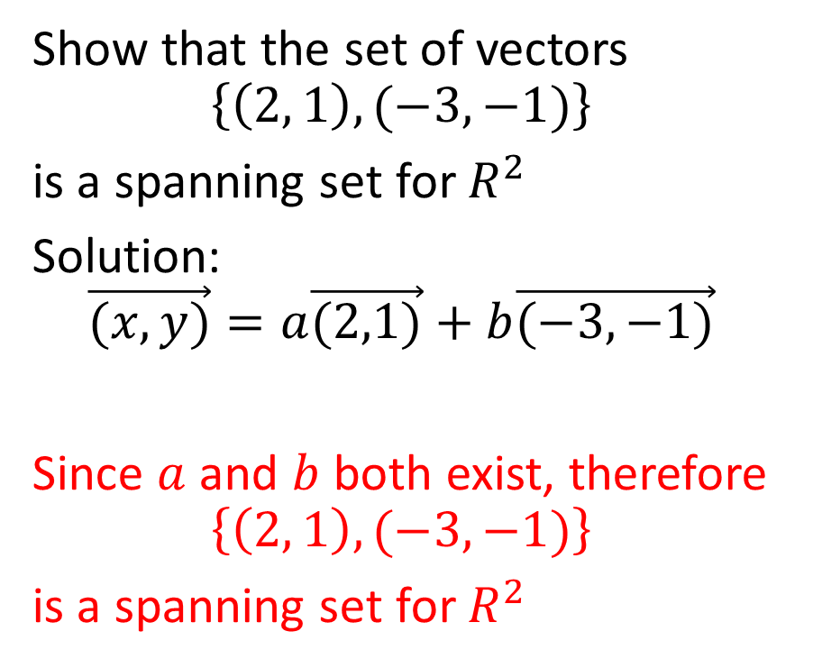
Show that the set of vectors
$$\left\{\left(2, 1\right), (−3, −1)\right\}$$
is a spanning set for $R^{2}$
Solution:
$$\vec{(x,y)}=a\vec{(2,1)}+b\vec{(−3,−1)}$$
Since $a$ and $b$ both exist, therefore
$$\left\{\left(2, 1\right), (−3, −1)\right\}$$
is a spanning set for $R^{2}$

Slide 37

Example
Using the expressions for a and b that we determined in the previous question, show that the vector $\vec{(−7,22)}$ is a linear combination of the vectors $\vec{(2,1)}$and $\vec{(−3,−1)}$

Slide 38
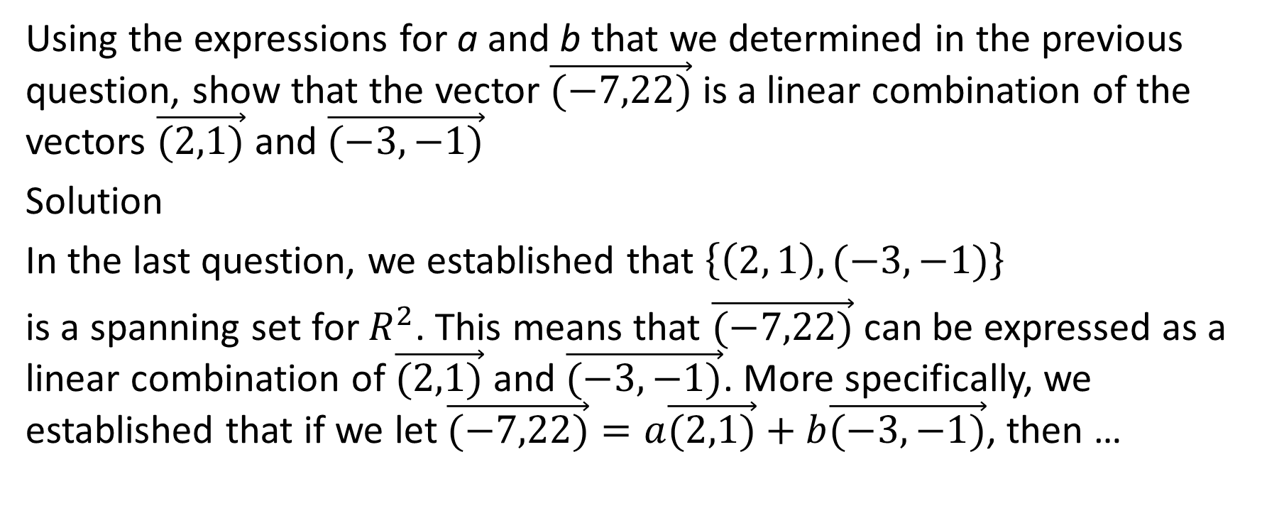
Using the expressions for a and b that we determined in the previous question, show that the vector $\vec{(−7,22)}$ is a linear combination of the vectors $\vec{(2,1)}$and $\vec{(−3,−1)}$
Solution
In the last question, we established that $\left\{\left(2, 1\right), (−3, −1)\right\}$
is a spanning set for $R^{2}$. This means that $\vec{(−7,22)}$ can be expressed as a linear combination of $\vec{(2,1)}$and $\vec{(−3,−1)}$. More specifically, we established that if we let $\vec{(−7,22)}=a\vec{(2,1)}+b\vec{(−3,−1)}$, then …

Slide 39
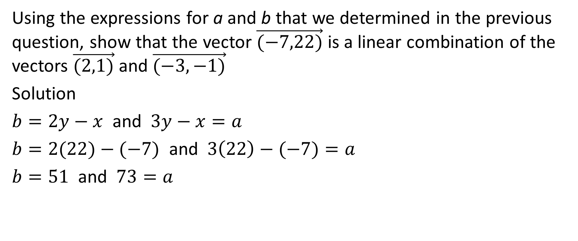
Using the expressions for a and b that we determined in the previous question, show that the vector $\vec{(−7,22)}$ is a linear combination of the vectors $\vec{(2,1)}$and $\vec{(−3,−1)}$
Solution
$b=2y−x$ and $3y−x=a$
$b=2(22)−(−7)$ and $3\left(22\right)−(−7)=a$
$b=51$ and $73=a$

Slide 40
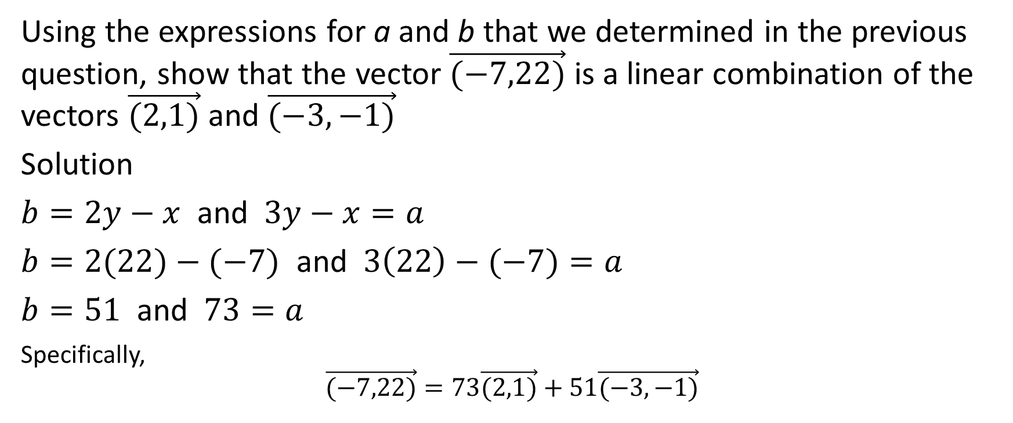
Using the expressions for a and b that we determined in the previous question, show that the vector $\vec{(−7,22)}$ is a linear combination of the vectors $\vec{(2,1)}$and $\vec{(−3,−1)}$
Solution
$b=2y−x$ and $3y−x=a$
$b=2(22)−(−7)$ and $3\left(22\right)−(−7)=a$
$b=51$ and $73=a$
Specifically,
$$\vec{(−7,22)}=73\vec{(2,1)}+51\vec{(−3,−1)}$$

Slide 41
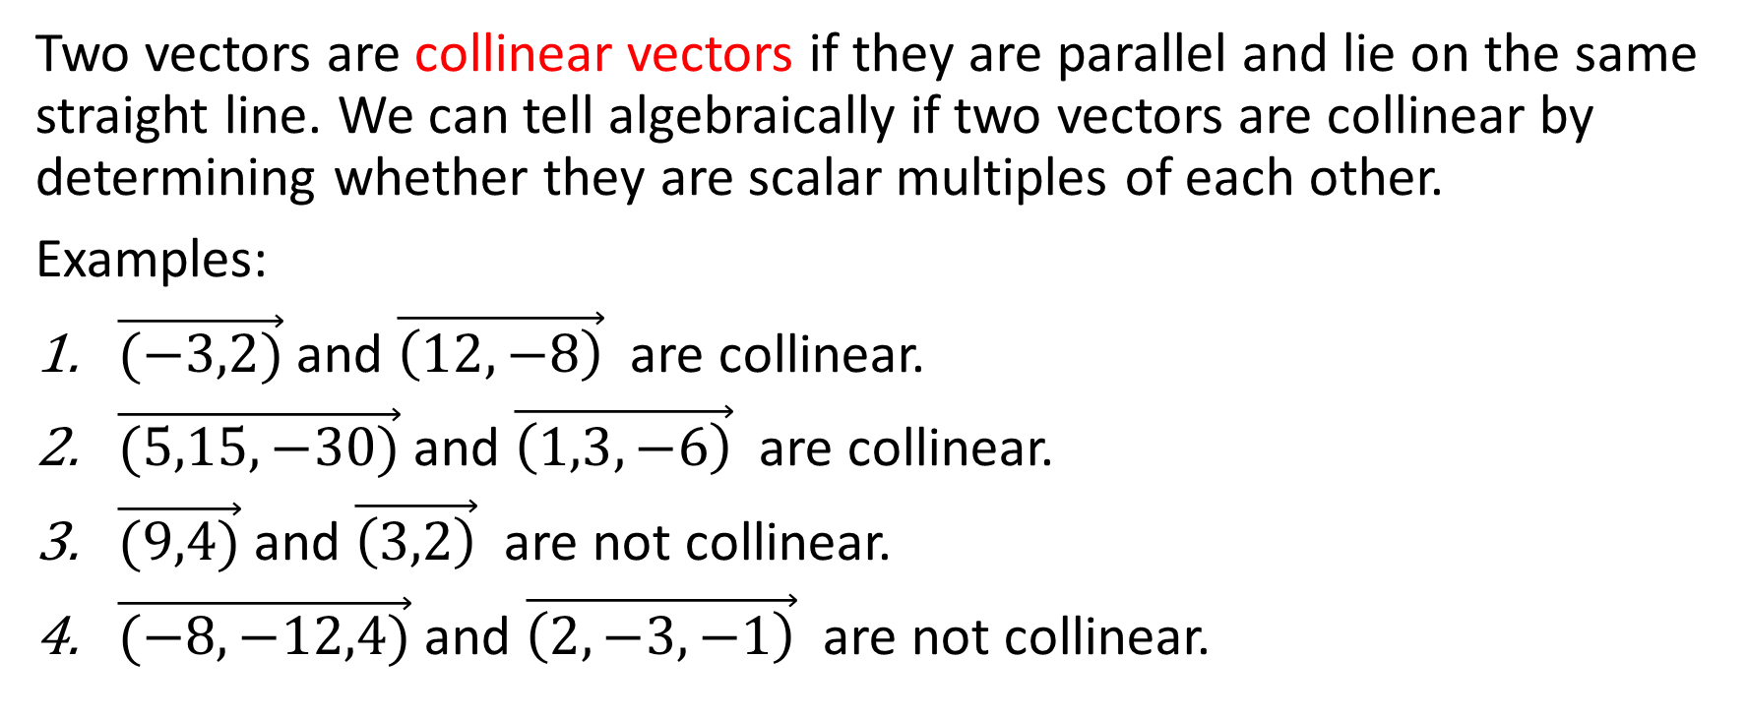
Terms to Know
Two vectors are collinear vectors if they are parallel and lie on the same straight line. We can tell algebraically if two vectors are collinear by determining whether they are scalar multiples of each other.
Examples:
$\vec{(−3,2)}$and $\vec{\left(12,−8\right)}$ are collinear.
$\vec{(5,15,−30)}$and $\vec{\left(1,3,−6\right)}$ are collinear.
$\vec{(9,4)}$and $\vec{\left(3,2\right)}$ are not collinear.
$\vec{(−8,−12,4)}$and $\vec{\left(2,−3,−1\right)}$ are not collinear.

Slide 42

General Rule Regarding Spanning Sets
Any two non-zero, non-collinear vectors in $R^{2}$ span $R^{2}$.
Any two collinear vectors in $R^{2}$ do not span $R^{2}$.

Slide 43
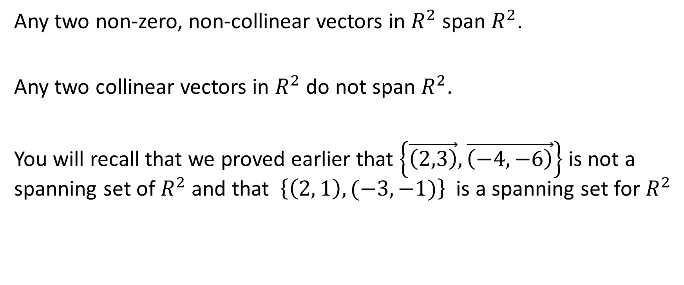
General Rule Regarding Spanning Sets
Any two non-zero, non-collinear vectors in $R^{2}$ span $R^{2}$.
Any two collinear vectors in $R^{2}$ do not span $R^{2}$.
You will recall that we proved earlier that $\left\{\vec{\left(2,3\right)}, \vec{\left(−4, −6\right)}\right\}$ is not a spanning set of $R^{2}$ and that $\left\{\left(2, 1\right), (−3, −1)\right\}$is a spanning set for $R^{2}$

Slide 44
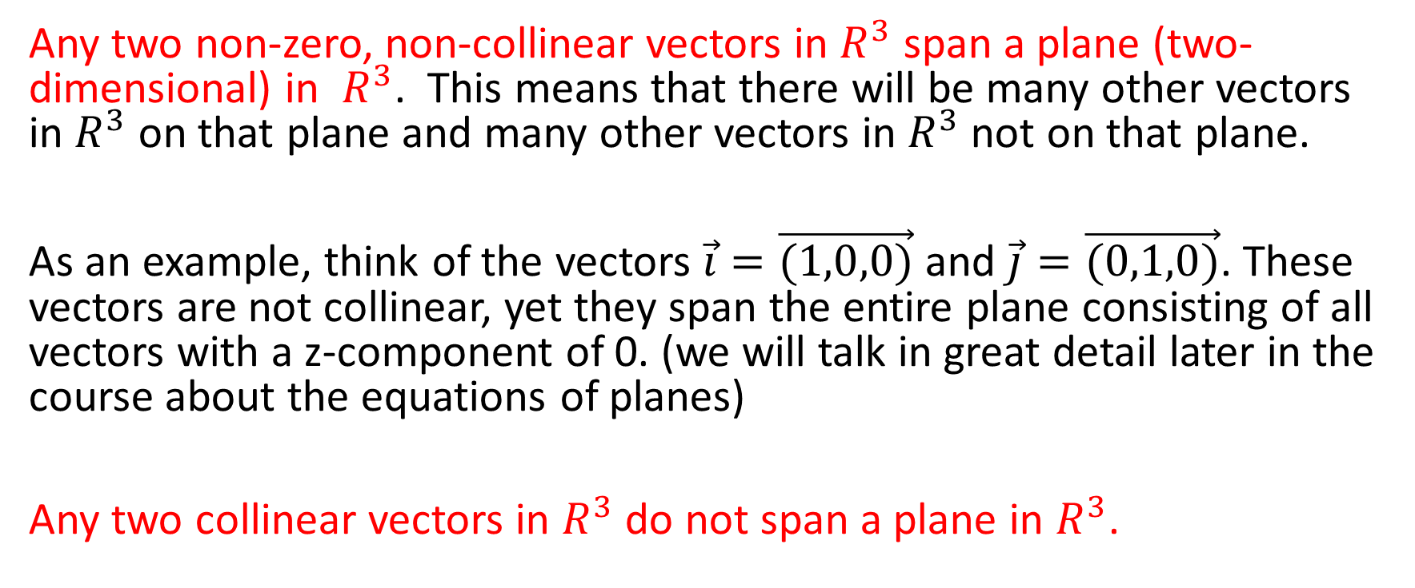
Another Similar and Related General Rule Regarding Spanning Sets
Any two non-zero, non-collinear vectors in $R^{3}$ span a plane (two-dimensional) in $R^{3}$. This means that there will be many other vectors in $R^{3}$ on that plane and many other vectors in $R^{3}$ not on that plane.
As an example, think of the vectors $\vec{i}=\vec{(1,0,0)}$ and $\vec{j}=\vec{(0,1,0)}$. These vectors are not collinear, yet they span the entire plane consisting of all vectors with a z-component of 0. (we will talk in great detail later in the course about the equations of planes)
Any two collinear vectors in $R^{3}$ do not span a plane in $R^{3}$.

Slide 45

Example:
Given the two vectors $\vec{a}=\vec{(−1,−2,1)}$ and $\vec{b}=\vec{(3,−1,1)}$, does the vector $\vec{c}=\left(−9,−4,1\right)$ lie on the plane spanned by $\vec{a}$ and $\vec{b}$?

Slide 46
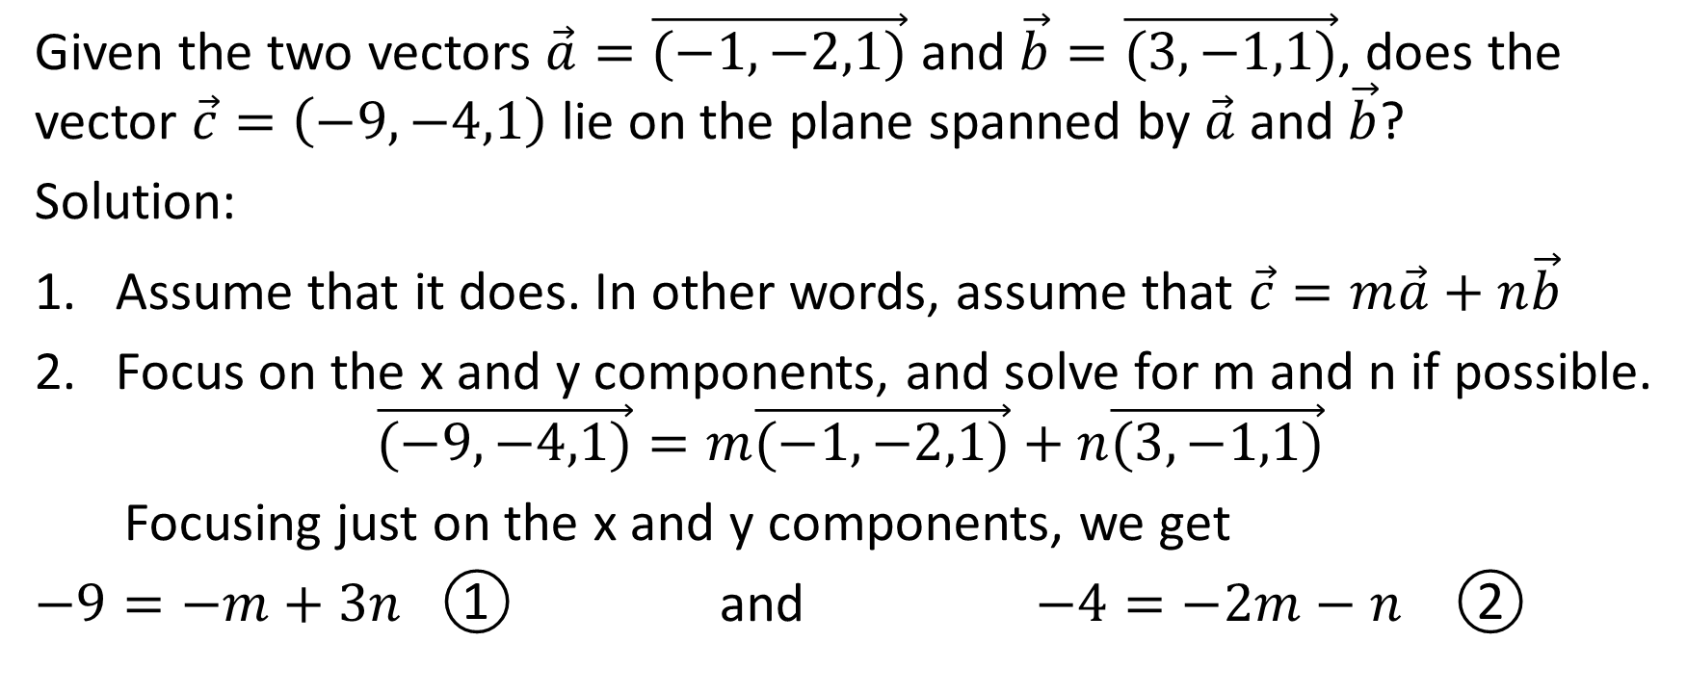
Given the two vectors $\vec{a}=\vec{(−1,−2,1)}$ and $\vec{b}=\vec{(3,−1,1)}$, does the vector $\vec{c}=\left(−9,−4,1\right)$ lie on the plane spanned by $\vec{a}$ and $\vec{b}$?
Solution:
Assume that it does. In other words, assume that $\vec{c}=m\vec{a}+n\vec{b}$
Focus on the x and y components, and solve for m and n if possible.
$$\vec{(−9,−4,1)}=m\vec{(−1,−2,1)}+n\vec{(3,−1,1)}$$
Focusing just on the x and y components, we get
$−9=−m+3n$ ① and $−4=−2m−n$ ②

Slide 47

$−9=−m+3n$ ① and $−4=−2m−n$ ②

Slide 48
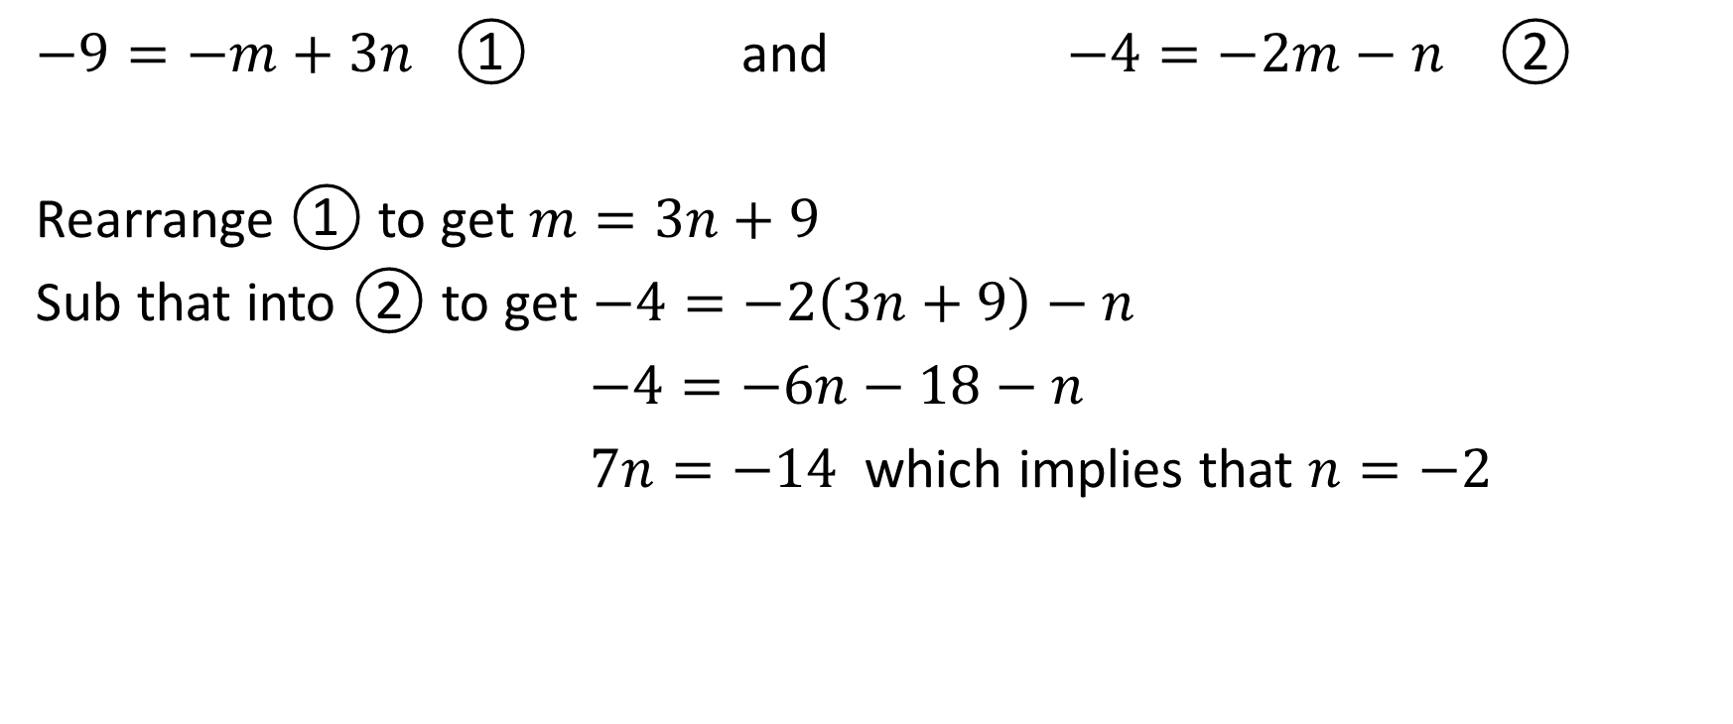
$−9=−m+3n$ ① and $−4=−2m−n$ ②
Rearrange ① to get $m=3n+9$
Sub that into ② to get $−4=−2\left(3n+9\right)−n$
$−4=−6n−18−n$
$7n=−14$ which implies that $n=−2$

Slide 49

$−9=−m+3n$ ① and $−4=−2m−n$ ②
Rearrange ① to get $m=3n+9$
Sub that into ② to get $−4=−2\left(3n+9\right)−n$
$−4=−6n−18−n$
$7n=−14$ which implies that $n=−2$
Plug that into either ① or ②
$−9=−m+3(−2)$ which implies that $m=3$

Slide 50

Does $\vec{(−9,−4,1)}=m\vec{(−1,−2,1)}+n\vec{(3,−1,1)}$ ?
Now that we have established that $m=3$ and $n=−2$, we need to see if those values work on the z-component
Focusing on the z-components, $1=m+n$
subbing in $m=3$ and $n=−2$, we get $1=3+(−2)$

Slide 51

Does $\vec{(−9,−4,1)}=m\vec{(−1,−2,1)}+n\vec{(3,−1,1)}$ ?
Now that we have established that $m=3$ and $n=−2$, we need to see if those values work on the z-component
Focusing on the z-components, $1=m+n$
subbing in $m=3$ and $n=−2$, we get $1=3+(−2)$
This is true! ☺

Slide 52

$\vec{(−9,−4,1)}=m\vec{(−1,−2,1)}+n\vec{(3,−1,1)}$
Now that we have established that $m=3$ and $n=−2$, we need to see if those values work on the z-component
Focusing on the z-components, $1=m+n$
subbing in $m=3$ and $n=−2$, we get $1=3+(−2)$
This is true! ☺
Therefore, $\vec{(−9,−4,1)}=3\vec{(−1,−2,1)}−2\vec{(3,−1,1)}$

Slide 53

$\vec{(−9,−4,1)}=3\vec{(−1,−2,1)}−2\vec{(3,−1,1)}$
Therefore, $\vec{(−9,−4,1)}$ lies on the plane spanned by $\vec{(−1,−2,1)}$ and $\vec{(3,−1,1)}$.

Slide 54

Example:
Given the two vectors $\vec{a}=\vec{(−1,−2,1)}$ and $\vec{b}=\vec{(3,−1,1)}$, does the vector $\vec{c}=\left(−9,−4,2\right)$ lie on the plane spanned by $\vec{a}$ and $\vec{b}$?

Slide 55

Given the two vectors $\vec{a}=\vec{(−1,−2,1)}$ and $\vec{b}=\vec{(3,−1,1)}$, does the vector $\vec{c}=\left(−9,−4,2\right)$ lie on the plane spanned by $\vec{a}$ and $\vec{b}$?
Solution:
Assume that it does. In other words, assume that $\vec{c}=m\vec{a}+n\vec{b}$
Focus on the x and y components, and solve for m and n if possible.
$$\vec{(−9,−4,2)}=m\vec{(−1,−2,1)}+n\vec{(3,−1,1)}$$
Focusing just on the x and y components, we get
$−9=−m+3n$ ① and $−4=−2m−n$ ②

Slide 56
$−9=−m+3n$ ① and $−4=−2m−n$ ②

Slide 57
$−9=−m+3n$ ① and $−4=−2m−n$ ②
Rearrange ① to get $m=3n+9$
Sub that into ② to get $−4=−2\left(3n+9\right)−n$
$−4=−6n−18−n$
$7n=−14$ which implies that $n=−2$

Slide 58
$−9=−m+3n$ ① and $−4=−2m−n$ ②
Rearrange ① to get $m=3n+9$
Sub that into ② to get $−4=−2\left(3n+9\right)−n$
$−4=−6n−18−n$
$7n=−14$ which implies that $n=−2$
Plug that into either ① or ②
$−9=−m+3(−2)$ which implies that $m=3$

Slide 59

Does $\vec{(−9,−4,2)}=m\vec{(−1,−2,1)}+n\vec{(3,−1,1)}$ ?
Now that we have established that $m=3$ and $n=−2$, we need to see if those values work on the z-component
Focusing on the z-components, $2=m+n$
subbing in $m=3$ and $n=−2$, we get $2≠3+(−2)$

Slide 60

Does $\vec{(−9,−4,2)}=m\vec{(−1,−2,1)}+n\vec{(3,−1,1)}$ ?
Now that we have established that $m=3$ and $n=−2$, we need to see if those values work on the z-component
Focusing on the z-components, $2=m+n$
subbing in $m=3$ and $n=−2$, we get $2≠3+(−2)$
They’re not equal! ☹

Slide 61

Does $\vec{(−9,−4,2)}=m\vec{(−1,−2,1)}+n\vec{(3,−1,1)}$ ?
Now that we have established that $m=−3$ and $n=2$, we need to see if those values work on the z-component
Focusing on the z-components, $2=m+n$
subbing in $m=3$ and $n=−2$, we get $2≠3+(−2)$
They’re not equal! ☹
Therefore, $\vec{(−9,−4,2)}≠m\vec{(−1,−2,1)}+n\vec{(3,−1,1)}$

Slide 62

$\vec{(−9,−4,2)}≠m\vec{(−1,−2,1)}+n\vec{(3,−1,1)}$
Therefore, $\vec{(−9,−4,2)}$ does not lie on the plane spanned by $\vec{(−1,−2,1)}$ and $\vec{(3,−1,1)}$.

Slide 63

Example
The vectors $\vec{u}$ and $\vec{v}$ span $R^{2}$. What values of $a$ and $b$ make the equation $a \vec{u}=b \vec{v}$ true?

Slide 64

The vectors $\vec{u}$ and $\vec{v}$ span $R^{2}$. What values of $a$ and $b$ make the equation $a \vec{u}=b \vec{v}$ true?
Solution:
Since $\vec{u}$ and $\vec{v}$ span $R^{2}$, this means that $\vec{u}$ and $\vec{v}$ are not collinear.
Therefore, it is impossible for the vectors to be nonzero scalar multiples of each other. Therefore, the coefficient of $\vec{u}$ and the coefficient of $\vec{v}$ must both be equal to zero.
$∴a=0$ and $b=0$

Slide 65

Example
The vectors $(1,−1,3)$, $(3,−2,4)$ and $(5, m, n)$ are coplanar. Determine three pairs of values for m and n for which this is true.

Slide 66

The vectors $(1,−1,3)$, $(3,−2,4)$ and $(5, m, n)$ are coplanar. Determine three pairs of values for m and n for which this is true.
Solution:
Since the three vectors shown are coplanar, therefore we know that there exist scalars $a$ and $b$ such that
$$\left(5,m,n\right)=a\left(1,−1,3\right)+b(3,−2,4)$$

Slide 67

The vectors $(1,−1,3)$, $(3,−2,4)$ and $(5, m, n)$ are coplanar. Determine three pairs of values for m and n for which this is true.
Solution:
$\left(5,m,n\right)=a\left(1,−1,3\right)+b(3,−2,4)$
From the x-components, $5=a+3b$
From the y-components, $m=−a−2b$
From the z-components, $n=3a+4b$

Slide 68

The vectors $(1,−1,3)$, $(3,−2,4)$ and $(5, m, n)$ are coplanar. Determine three pairs of values for m and n for which this is true.
Solution:
$\left(5,m,n\right)=a\left(1,−1,3\right)+b(3,−2,4)$
$5=a+3b$ ❶
$m=−a−2b$ ❷
$n=3a+4b$ ❸

Slide 69
The vectors $(1,−1,3)$, $(3,−2,4)$ and $(5, m, n)$ are coplanar. Determine three pairs of values for m and n for which this is true.
Solution:
$\left(5,m,n\right)=a\left(1,−1,3\right)+b(3,−2,4)$
$5=a+3b$ ❶
$m=−a−2b$ ❷
$n=3a+4b$ ❸
We have three equations with four unknowns. It is impossible to solve for any of these values without assigning a value to at least one of the variables given. We have more unknowns than equations.

Slide 70
The vectors $(1,−1,3)$, $(3,−2,4)$ and $(5, m, n)$ are coplanar. Determine three pairs of values for m and n for which this is true.
Solution:
$\left(5,m,n\right)=a\left(1,−1,3\right)+b(3,−2,4)$
$5=a+3b$ ❶
$m=−a−2b$ ❷
$n=3a+4b$ ❸
This is just like when you first learned how to graph lines. You were given an equation with both x and y, and the only way you could get ordered pairs for x and y was to substitute a real number value in for either x or y and then to solve for the other one.

Slide 71
The vectors $(1,−1,3)$, $(3,−2,4)$ and $(5, m, n)$ are coplanar. Determine three pairs of values for m and n for which this is true.
Solution:
$\left(5,m,n\right)=a\left(1,−1,3\right)+b(3,−2,4)$
$5=a+3b$ ❶
$m=−a−2b$ ❷
$n=3a+4b$ ❸
We will need to choose a value for one of the four unknowns and determine if we can get values for the others. We will do some algebra first.

Slide 72


The vectors $(1,−1,3)$, $(3,−2,4)$ and $(5, m, n)$ are coplanar. Determine three pairs of values for m and n fo which this is true.
Solution:
$\left(5,m,n\right)=a\left(1,−1,3\right)+b(3,−2,4)$
$5=a+3b$ ❶
$m=−a−2b$ ❷
$n=3a+4b$ ❸
Rearrange ❶ to get $a=5−3b$ ❹
Sub that into ❷ to get $m=−\left(5−3b\right)−2b$
$m=−5+3b−2b$
$m=b−5$ ❺
Sub $a=5−3b$ into ❸ to get $n=3\left(5−3b\right)+4b$
$n=15−9b+4b$
$n=15−5b$ ❻

Slide 73
The vectors $(1,−1,3)$, $(3,−2,4)$ and $(5, m, n)$ are coplanar. Determine three pairs of values for m and n fo which this is true.
Solution:
$\left(5,m,n\right)=a\left(1,−1,3\right)+b(3,−2,4)$
$5=a+3b$ ❶
$m=−a−2b$ ❷
$n=3a+4b$ ❸
In summary, $a=5−3b$ ❹, $m=b−5$ ❺ and $n=15−5b$ ❻

Slide 74

The vectors $(1,−1,3)$, $(3,−2,4)$ and $(5, m, n)$ are coplanar. Determine three pairs of values for m and n fo which this is true.
Solution:
$\left(5,m,n\right)=a\left(1,−1,3\right)+b(3,−2,4)$
$5=a+3b$ ❶
$m=−a−2b$ ❷
$n=3a+4b$ ❸
In summary, $a=5−3b$ ❹, $m=b−5$ ❺ and $n=15−5b$ ❻
We don’t need equation $❹$any more. Focusing just on equation ❺ and ❻, we have two equations with three unknowns. We need to assign a value to one of them and then solve for the other two. Since both of those equations are in terms of b, we will pick three possible values for b and then determine the appropriate values for m and n

Slide 75

The vectors $(1,−1,3)$, $(3,−2,4)$ and $(5, m, n)$ are coplanar. Determine three pairs of values for m and n fo which this is true.
Solution:
$\left(5,m,n\right)=a\left(1,−1,3\right)+b(3,−2,4)$
$5=a+3b$ ❶
$m=−a−2b$ ❷
$n=3a+4b$ ❸
In summary, $m=b−5$ ❺ and $n=15−5b$ ❻
$b=1$ implies $m=−4$ and $n=10$
$b=2$ implies $m=−3$ and $n=5$
$b=3$ implies $m=−2$ and $n=0$

Slide 76

The vectors $(1,−1,3)$, $(3,−2,4)$ and $(5, m, n)$ are coplanar. Determine three pairs of values for m and n fo which this is true.
Solution:
$\left(5,m,n\right)=a\left(1,−1,3\right)+b(3,−2,4)$
$5=a+3b$ ❶
$m=−a−2b$ ❷
$n=3a+4b$ ❸
Therefore, the three vectors given are coplanar if
$m=−4$ and $n=10$ , or if $m=−3$ and $n=5$ , or if $m=−2$ and $n=0$
There are many other possible pairs of values as well.

